Slide 1
Data Modelling, Management & Governance CIS108-6 Review
Dr Gangmin Li

Slide 2
Introduction
Managing data is an area of crucial importance in any field.
Its application facilitates the rational decision making process that is the basis for successful operations within any environment.
We are living in a BIG data Age. Data is everywhere.
Data is the most valuable assets for every organisation.
Manage data is foundation for any business activities and achieve business goals.

Slide 3
The purpose of the unit
To discuss how data should be managed during its lifecycle through a mixture of relevant topics includes development tools and basic techniques for data capture, modelling, storing and retrieval to serve as the mechanisms for making effective and efficient use of available data.
The approach will be based on exploring basic applied principles and practices
To enable students to develop an information system as a solution to a problem for a particular field of application. These are fully informed from practices employed in small to middle and, middle to large sized companies.

Slide 4
Aim and Objectives
Advance knowledge by exploring and applying theoretical and practical techniques for data modelling and management
to develop appropriate relational database systems for managing data within a chosen field of interest
Review database and data modelling theory & techniques
Appreciate and exploit available methods & techniques
Develop awareness & ability to select & apply appropriate tools & techniques to build database systems
Demonstrate good practice
Apply data modelling & management tools in field of interest
Notes:
Aims and objectives of DMM unit

Slide 5
Syllabus
Introduction to Data Modelling and Management
Data Modelling and Dynamic Modelling Techniques (e.g. UML, semantic modelling)
Conceptual Database Design (Entity-Relationship models)
Logical Database Design (Normalisation)
Data querying (e.g. SQL)
Integrity, Security, Recovery and Concurrency
Data Governance
Trends and Future Developments (e.g. semantic web and clouds computing)

Slide 6
Learning Outcomes
1. Demonstrate the following knowledge and understanding. Exhibit a balanced and systematic understanding and knowledge of data modelling and management theory and data governance practice (including querying languages).
2. Demonstrate the following skills and abilities. Apply knowledge of data modelling and management concepts to design, develop and critically evaluate an information system within a chosen field of interest.

Slide 7
Knowledge Map
System requirements gathering
and modelling
A data system is a computer
system
that manages data
How to design
a data system?
SSM
Conceptual models
A rich picture
Root Definition: CATWOE
Conceptual Models

Slide 8
Knowledge Map
How to model a system
(which has Root definition and
a conceptual model)
For communication?
Use case diagram
To identify and express
typical use cases and
Communication with users
UML
Activity Diagrams
To identify and model content
of use cases in all activities
Class Diagrams
the (objects) classes of the system
attributes (objects)
The relationships (among objects)
their operations (or methods)

Slide 9
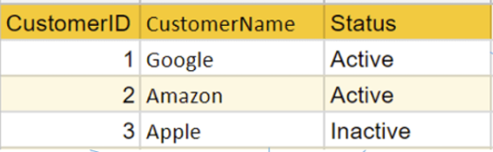
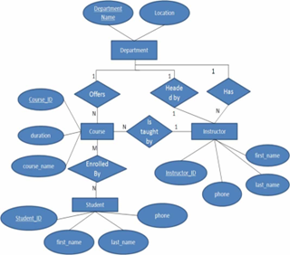
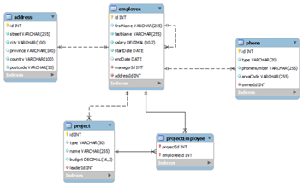
Knowledge Map
Data modelling (ERM)
defines the real-world
entities and relationships
ERD
Identify entities
Identify attributes
Identify relationships between entities
Determine attribute domains (e.g. datatypes)
Determine candidate primary keys
Draw entity relationship diagram
Database Design
Database modelling
RDB – table design (RDM)
Chen’s Notation
Database Normalisation
Crow’s Foot Notation
1NF: atomic value
Function dependency
2NF: NOT partially dependency
3NF: No transitive dependency

Slide 10
Knowledge Map
RDBMS
Data are structured
ACID Rules (AC)
Database
NoSQL
Data are unstructured
or semi-structured
BASE Rule (CP or AP)
Flexible schema
Massive scalability
Document-oriented
MongoDB
Graph database
Neo4j
Key-Value Pairs
Redis
Column based
Cassandra

Slide 11
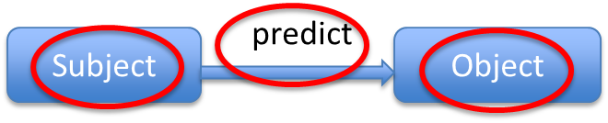
Knowledge Map
Data semantic modelling
Restrict big data meaning
Eliminate “ill-representation”
Graph model
Object - RelationType – Object
Semantic web
RDF
Web 3.0
Connect data
Remove the app silos
Ontological Modelling
concepts,
relations,
instances and
axioms.

Slide 12
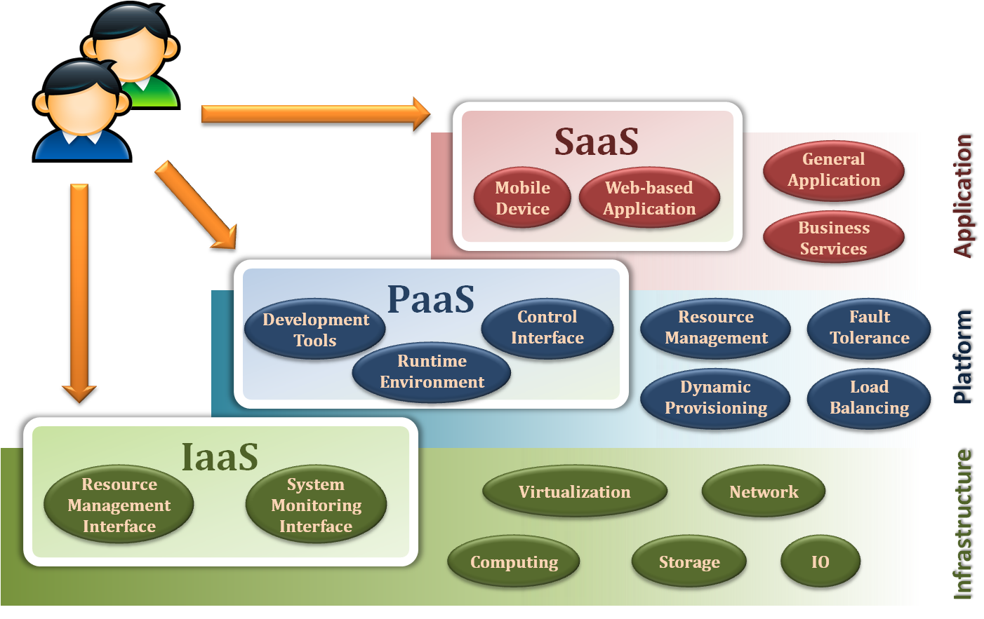
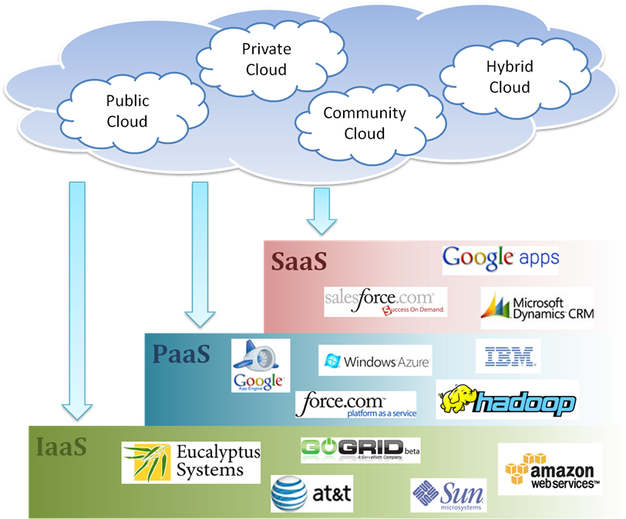
Knowledge Map
Environment that
Database Deploy/Running
Web Service
SOA
Scalability
Elasticity
Dynamic Provisioning
Availability & Reliability
Service Models
Clouds
Grid computing
Sharing resources
(utility computing)
Sharing services
(edge computing)
Ubiquity
Cloud Ecosystem

Slide 13
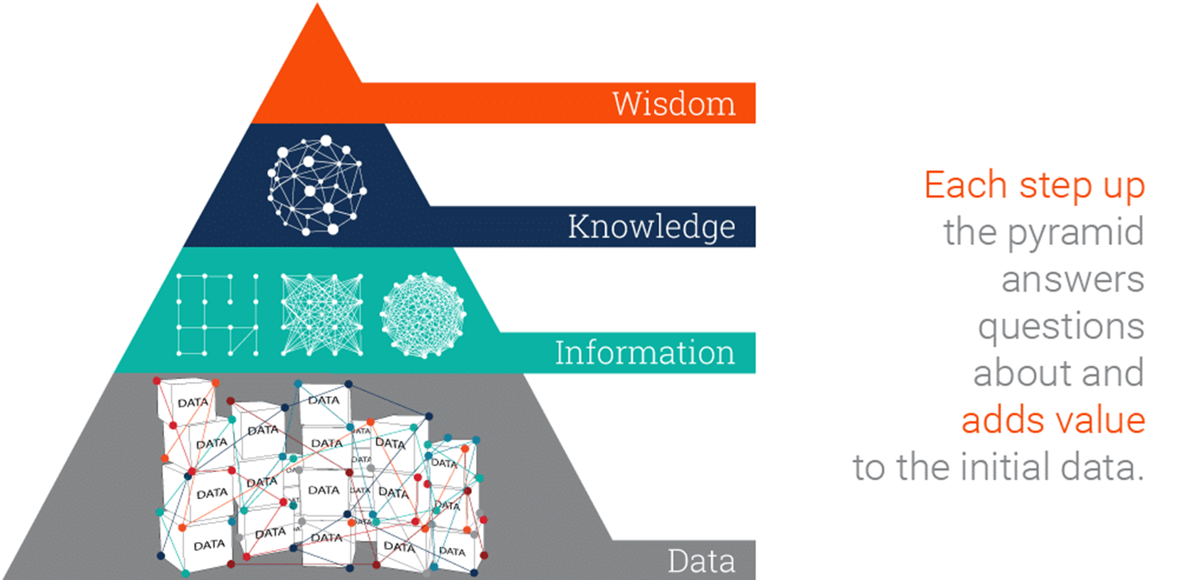
Knowledge Map
Report
Application
1
Application
2
Enquiry
Retrieve
Update
Delete
Database Management System
Control
Security
Integrity
DATASTORE
Modules data Students data
Data
Process
People

Slide 14
END
Thank you all

